Slide 1

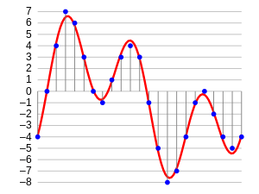
Sound Classification &
Segmentation

Slide 2


Problem
cat
Start point
class
End point
2

Slide 3

CONTENTS
SOUND & WAVEFORMS
WHAT SHOULD YOU EXPECT
AUDIO FEATURES & THEIR EXTRACTION
AAHO – CNN (Deep Learning Model)
Arslan Analytics Hear Once (AAHO) is a custom made convolutional neural network to classify and localize acoustic objects in sound waves

Slide 4
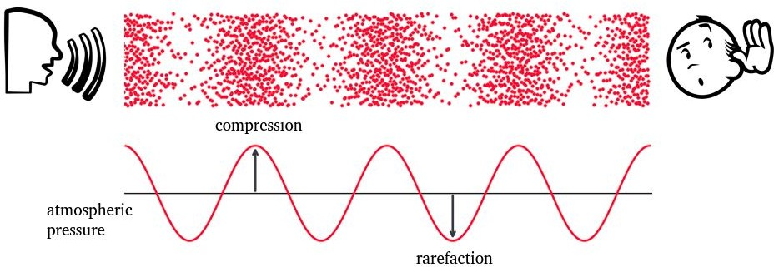
Sound wave
4

Slide 5
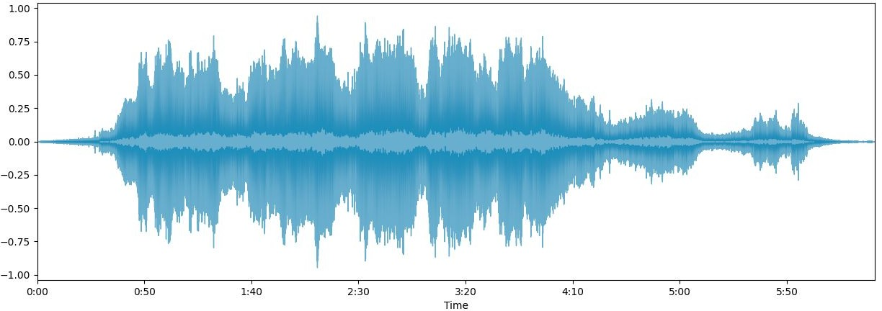
Waveform
Carries multifactorial information:
Frequency
Intensity
Sample rate:
Number of samples of audio recorded every second
A common audio sample rate for music is 44,100 samples per second
5

Slide 6
CONTENT
SOUND & WAVEFORMS
WHAT SHOULD YOU EXPECT !
AUDIO FEATURES & ITS EXTRACTION
AAHO – CNN (Deep Learning Model)
Arslan Analytics Hear Once (AAHO) is a custom made convolutional neural network to classify and localize acoustic object in sound waves

Slide 7
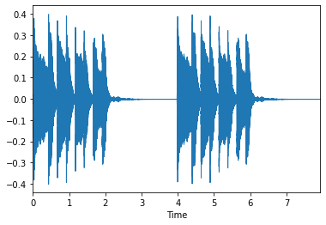
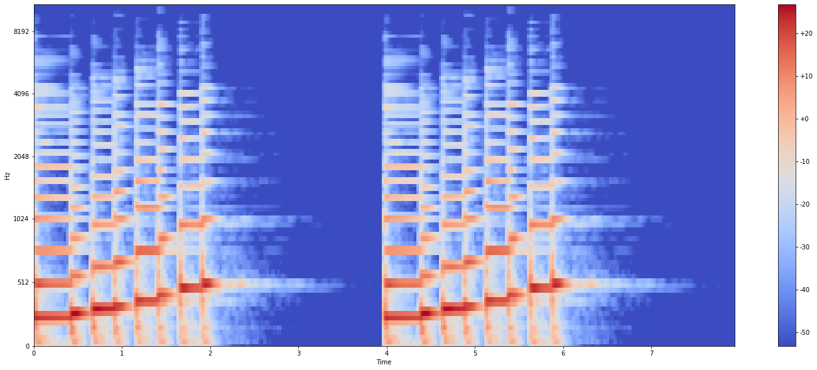

Don’t freak out!
Mel Spectrogram
7

Slide 8
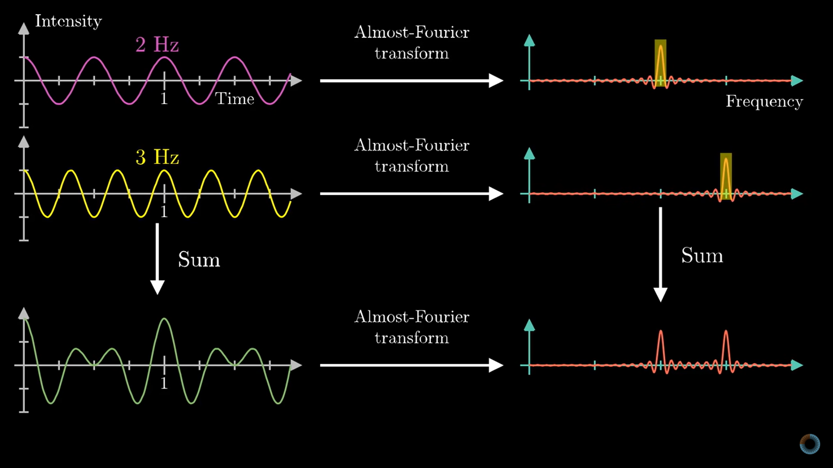
Intuition Behind Fourier Transform
Fourier Transform:
Convert the signal from time domain into frequency domains
Sound waves are composed of multiple signals. In frequency domain, we can tell how many frequencies (acoustic waves) are present in the sound
3Blue1Brown
8

Slide 9
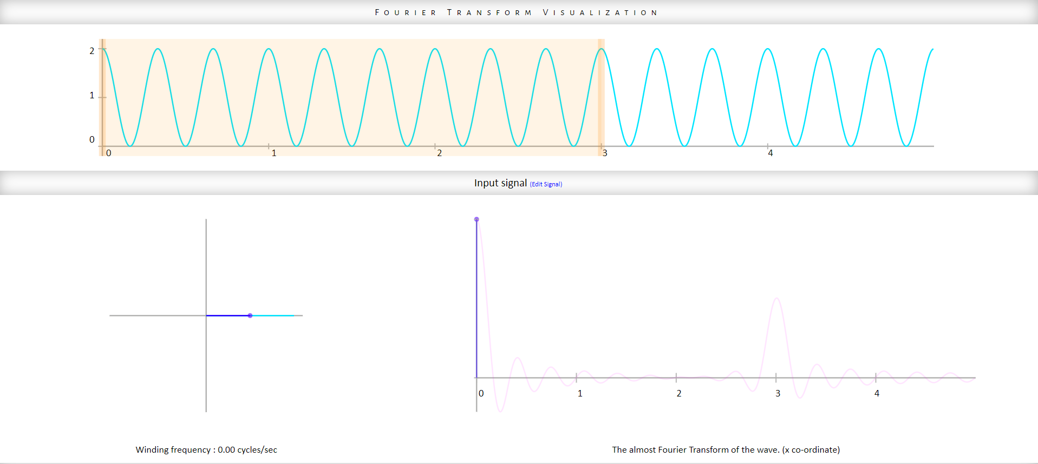
Intuition Behind Fourier Transform
9

Slide 10
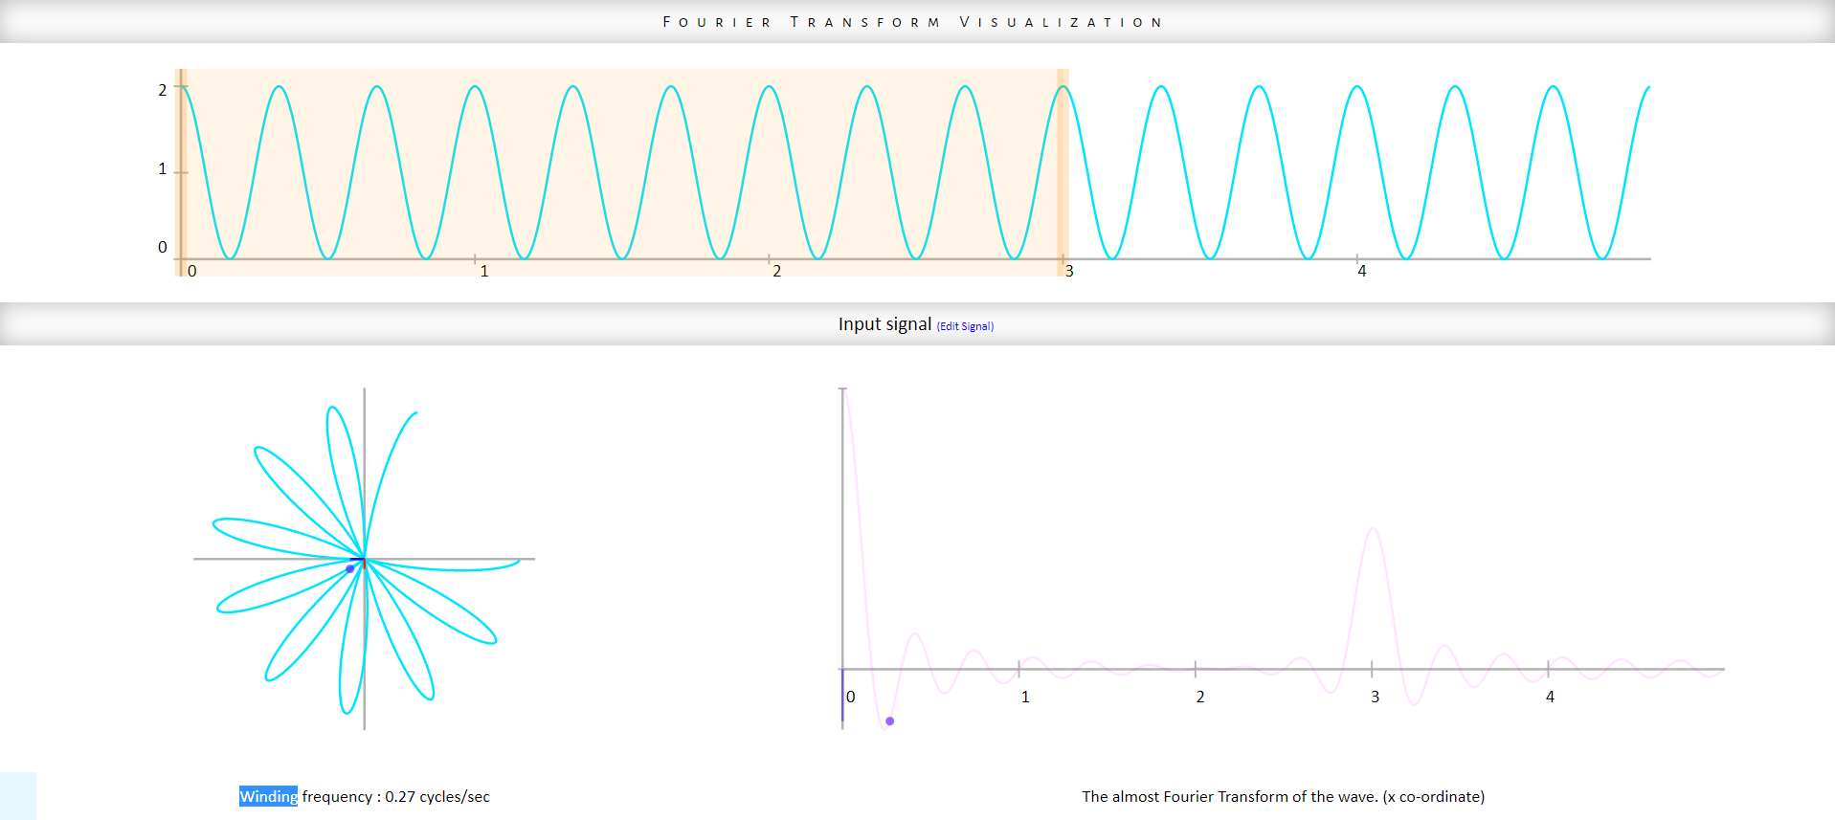
Intuition Behind Fourier Transform
10

Slide 11
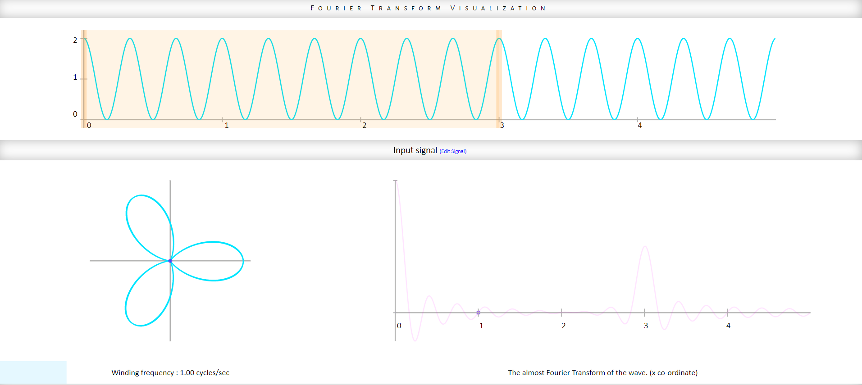
Intuition Behind Fourier Transform
11

Slide 12
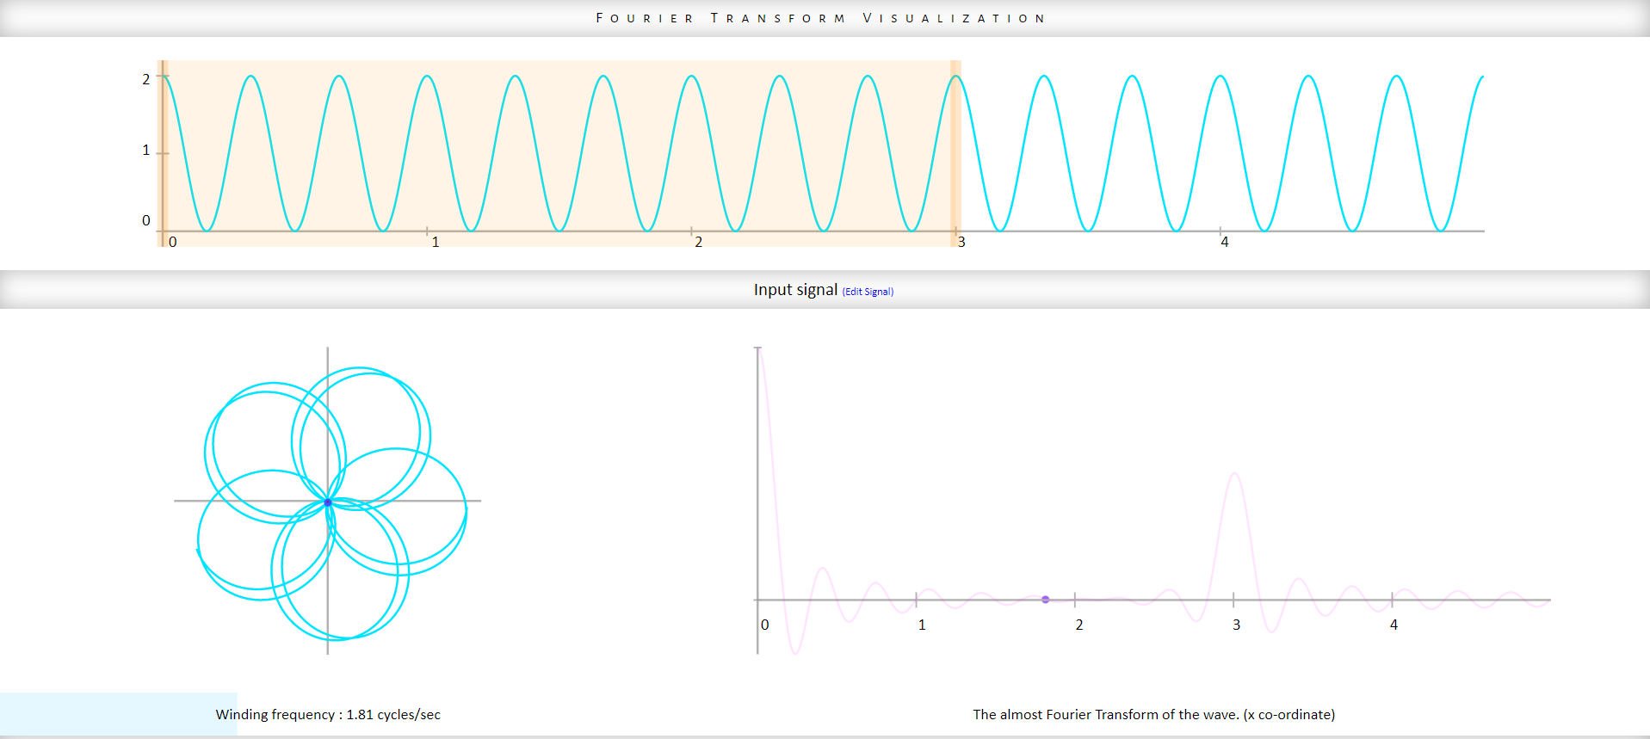
Intuition Behind Fourier Transform
12

Slide 13
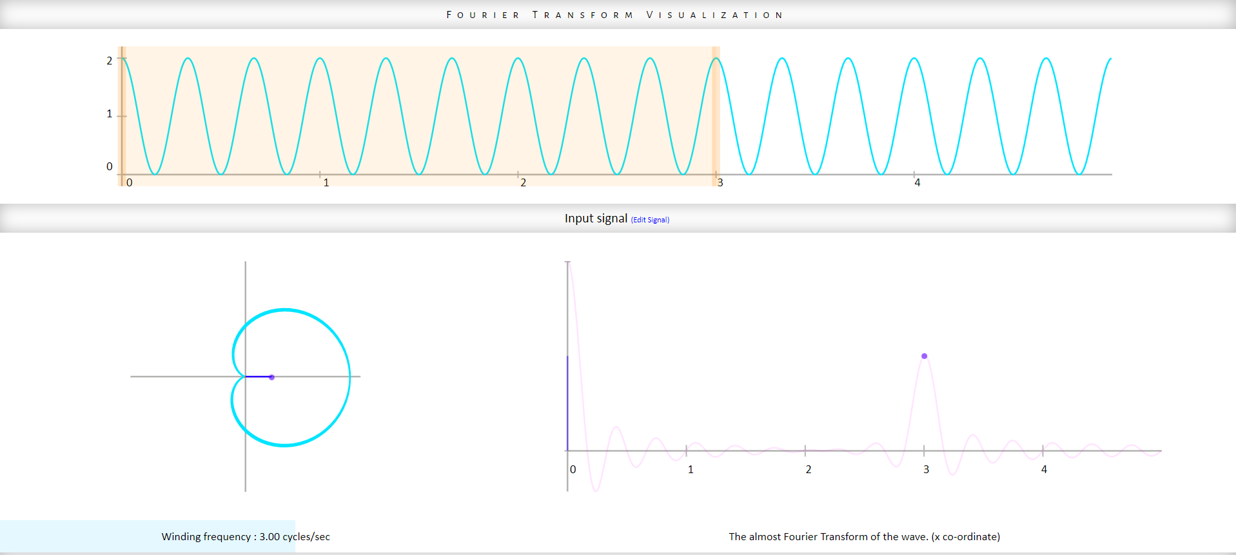
Intuition Behind Fourier Transform
13

Slide 14
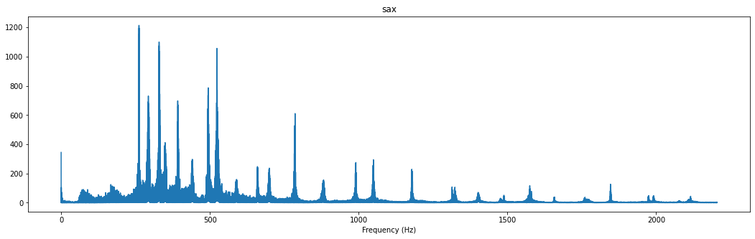

Example of Fourier Transform
What should be the ideal audio feature ?
Time – frequency Representation ?
How to do that ?
14

Slide 15
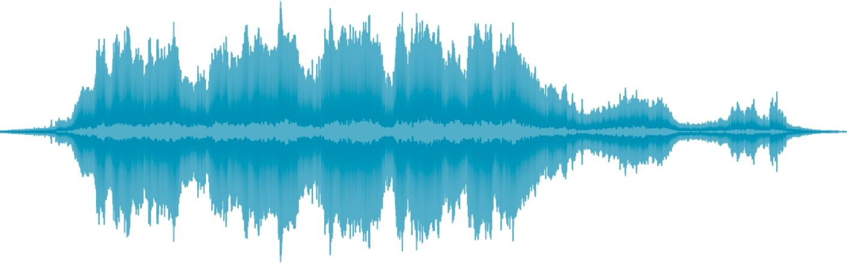
Short Time Fourier Transform
15

Slide 16
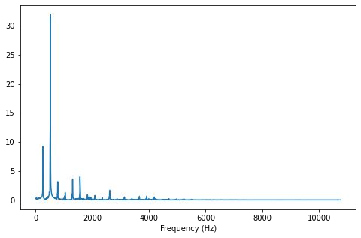
Short Time Fourier Transform
16

Slide 17
Short Time Fourier Transform
17

Slide 18
Short Time Fourier Transform
18

Slide 19
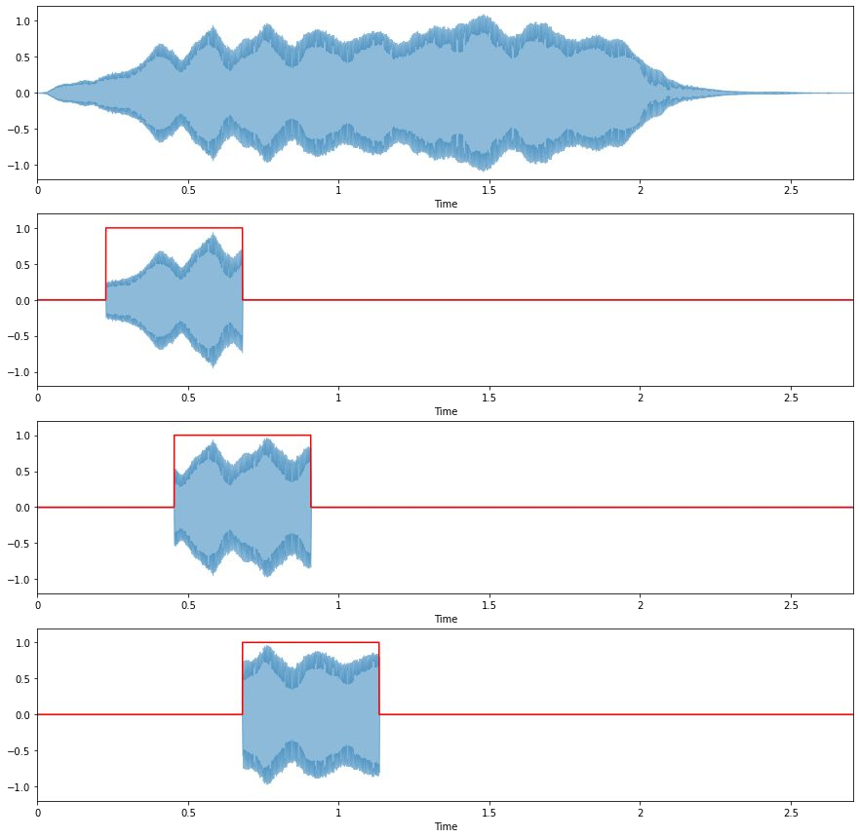
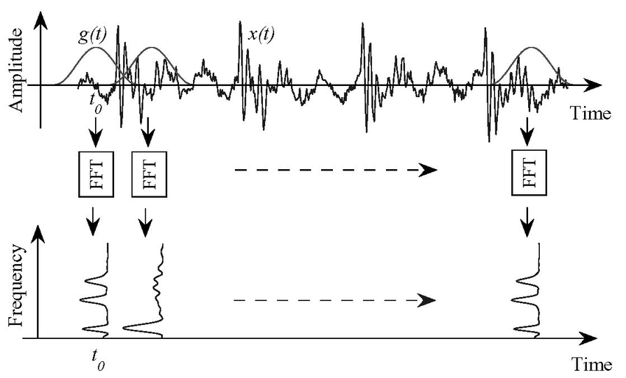
Short Time Fourier Transform
Overlapping Windows (hop size)
Frames or Proxies of time stamp
19

Slide 20
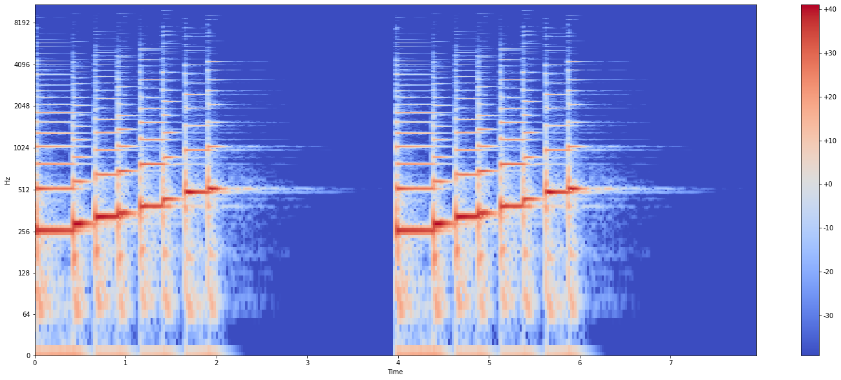
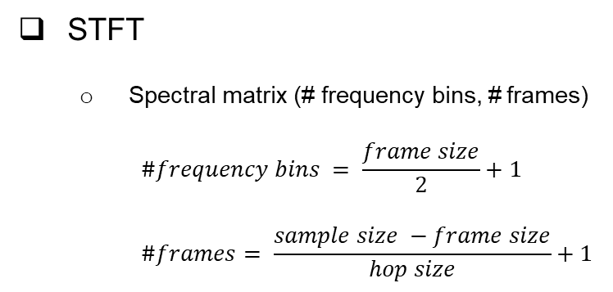
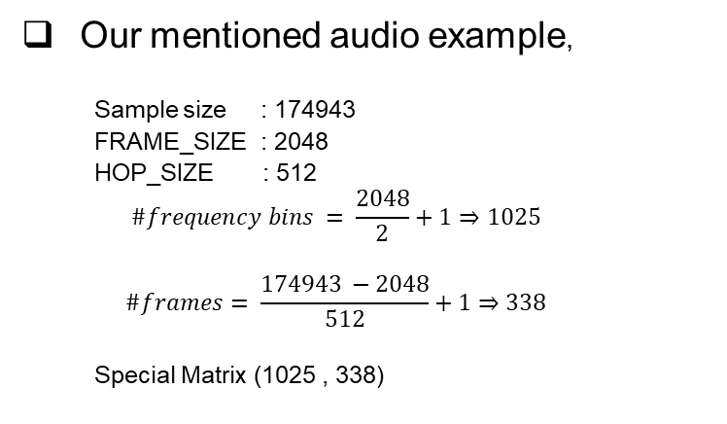
Output Matrix of STFT
STFT
Spectral matrix (# frequency bins, # frames)
$$\#frequency bins = \frac{frame size}{2}+1$$
$$\#frames= \frac{sample size −frame size}{hop size}+1$$
Our mentioned audio example,
Sample size : 174943
FRAME_SIZE : 2048
HOP_SIZE : 512
$$\#frequency bins = \frac{2048}{2}+1⇒1025$$
$$\#frames= \frac{174943 −2048}{512}+1⇒338$$
Special Matrix (1025 , 338)
Number of Frames
20

Slide 21
Wondering If we have time-frequency spectrogram matrix then why don’t we use it as ideal sound feature ?
keep on thinking !

Slide 22
Psychoacoustic Experiment
1st example: C2 – C4 => (65 – 262Hz)
2nd example: G6 – A6 => (1568 – 1760Hz)
200 Hz
What should be the ideal audio feature ?
Time – frequency Representation
Perceptually-relevant frequency representation
Mel Spectrograms (equal distances on the scale have same “perceptual” distance)
1st pair of note (500ml – 510ml)
2nd pair of note (1000ml – 1010ml)
Perceptual distance and pitch distance is same
22

Slide 23
Convert Frequencies to Mel Scale
Choose number of “Mel” bands
Construct “Mel” filter banks
Apply “Mel” filter banks to spectrogram
40
128
60
90
How many mel bands?
It depends on the problem!
23

Slide 24
Convert Frequencies to Mel Scale
Choose number of “Mel” bands
Construct “Mel” filter banks
Apply “Mel” filter banks to spectrogram
24

Slide 25
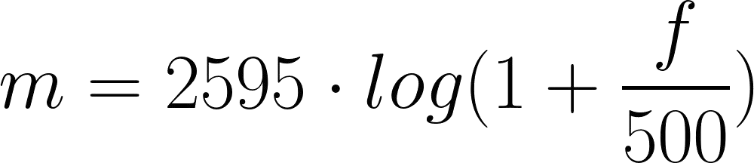



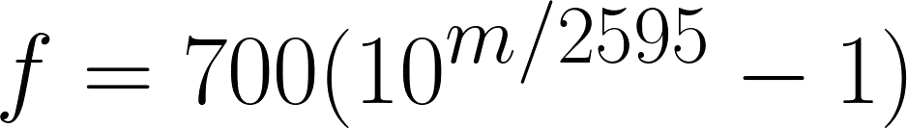
Mel Scale
Convert lowest / highest frequency to Mel
Create # bands equally spaced points
Convert points back to Hertz
Round to nearest frequency bin
Create triangular filters
25

Slide 26
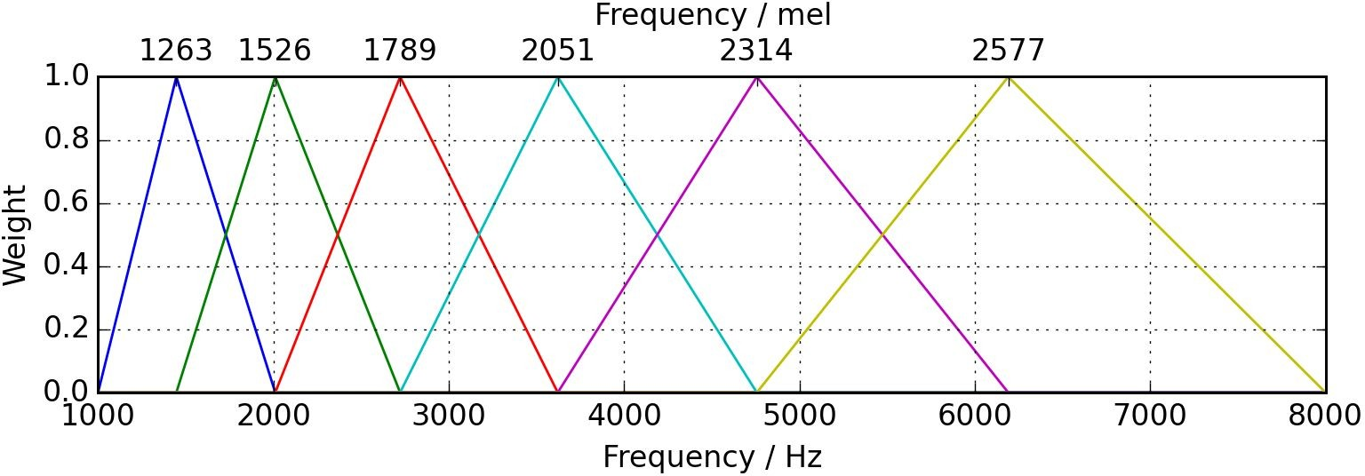
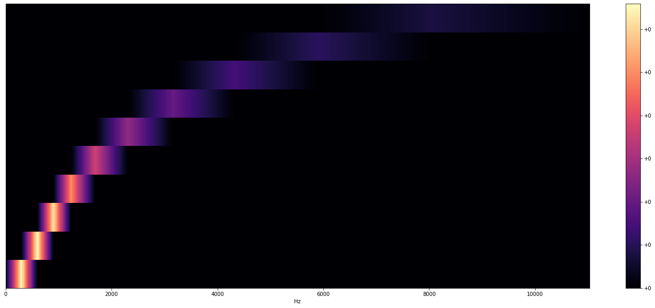
Mel Scale
26

Slide 27
Convert Frequencies to Mel Scale
Choose number of “Mel” bands
Construct “Mel” filter banks
Apply “Mel” filter banks to spectrogram
27

Slide 28
Apply “Mel” filter bands to spectrogram
M = (# bands, framesize / 2 + 1)
Y = (framesize / 2 + 1, # frames)
M = (# bands, framesize / 2 + 1)
Y = (framesize / 2 + 1, # frames)
Mel spectrogram = MY (# bands, # frames)
28

Slide 29
Now you can freak out ☺
Mel Spectrogram
29

Slide 30
CONTENT
SOUND & WAVEFORMS
WHAT SHOULD YOU EXPECT !
AUDIO FEATURES & ITS EXTRACTION
AAHO – CNN (Deep Learning Model)
Arslan Analytics Hear Once (AAHO) is a custom made convolutional neural network to classify and localize acoustic object in sound waves

Slide 31
AAHO – CNN for Audio Segmentation
Training Dataset
Ground Truth Labels
CNN Architecture
Evaluation & Optimization
Results
31

Slide 32
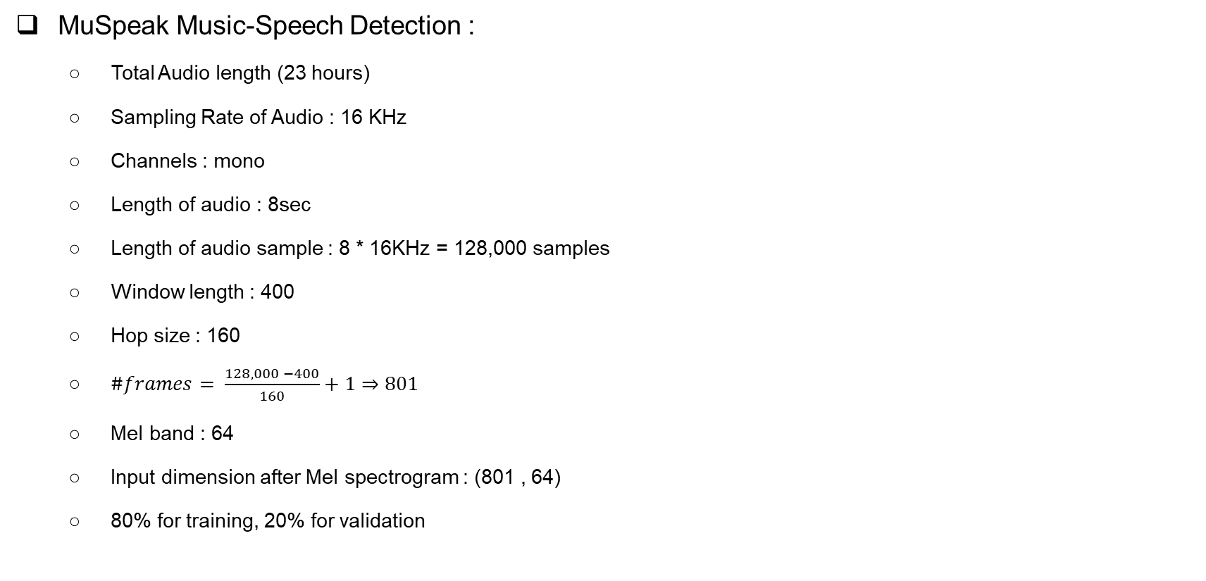
Training Dataset
MuSpeak Music-Speech Detection :
Total Audio length (23 hours)
Sampling Rate of Audio : 16 KHz
Channels : mono
Length of audio : 8sec
Length of audio sample : 8 * 16KHz = 128,000 samples
Window length : 400
Hop size : 160
$\#frames= \frac{128,000 −400}{160}+1⇒801$
Mel band : 64
Input dimension after Mel spectrogram : (801 , 64)
80% for training, 20% for validation
32

Slide 33
Ground Truth Labels
Ground-truth label marking:
Txt file containing time stamps of event start
Example, [ [ 0 , 2.3 , “music”] , [ 4 , 6.3 , “music”] ]
33

Slide 34
Ground Truth Labels
Layertype | Filters | Shape/Stride | Outputshape
Reshape | - | - | 801x64x1
Conv2D | 32 | 3x3/2 | 401x32x32
Conv2D-dw | - | 3x3 | 401x32x32
Conv2D | 64 | 1x1 | 401x32x64
Conv2D-dw | - | 3x3/2 | 201x16x64
Conv2D | 128 | 1x1 | 201x16x128
Conv2D-dw | - | 3x3 | 201x16x128
Conv2D | 128 | 1x1 | 201x16x128
Conv2D-dw | - | 3x3/2 | 101x8x128
Conv2D | 256 | 1x1 | 101x8x256
Conv2D-dw | - | 3x3 | 101x8x256
Conv2D | 256 | 1x1 | 101x8x256
Conv2D-dw | - | 3x3/2 | 51x4x256
Conv2D | 512 | 1x1 | 51x4x256
. | . | . | .
. | . | . | .
. | . | . | .
Conv2D | 256 | 1x1 | 26x2x256
Conv2D-dw | - | 3x3 | 26x2x256
Conv2D | 128 | 1x1 | 26x2x128
Reshape | - | - | 26x256
Conv1D | 6 | 1 | 26x6
INPUT
Discussed in previous slides
OUTPUT
34

Slide 35
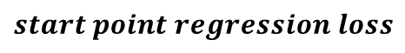
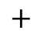
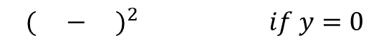
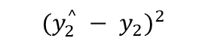
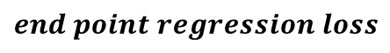
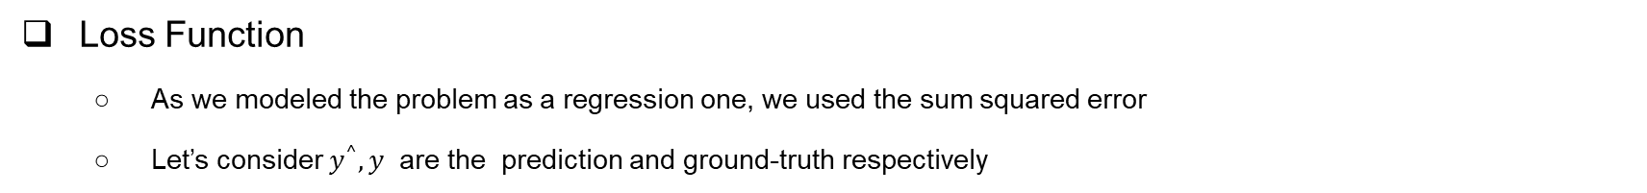
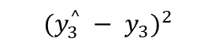
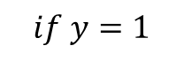
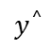
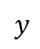
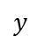
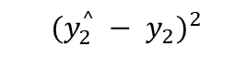
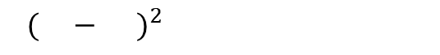
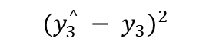
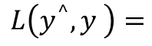

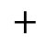
Evaluation & Optimization
Loss Function
As we modeled the problem as a regression one, we used the sum squared error
Let’s consider $y^{^},y$ are the prediction and ground-truth respectively
$$y$$
$$y^{^}$$
If$y=0 then$ $y^{^}$ should be 0
$$y$$
$$y^{^}$$
If$y=1 then$ $y^{^}$ should be 1
$$\{$$
$${ ( − )}^{2} if y=0$$
AND
$$L\left(y^{^}, y \right)=$$
$${ ( − )}^{2}$$
$${ (y_{2}^{^} − y_{2})}^{2}$$
$${ (y_{2}^{^} − y_{2})}^{2}$$
$$start point regression loss$$
$$+$$
$$if y=1$$
AND
$$+$$
$${ (y_{3}^{^} − y_{3})}^{2}$$
$${ (y_{3}^{^} − y_{3})}^{2}$$
$$end point regression loss$$
35

